Slide 1


Ronald Mbanga
19 Jan 2023
Name: Ronald Mbanga
Date: 18 January 2023

Slide 2
Outline
Executive Summary
Introduction
Methodology
Results
Conclusion
Appendix

Slide 3
Executive Summary
Summary of methodologies
Data Collection through API
Data Collection with Web Scraping
Data Wrangling
Exploratory Data Analysis with SQL
Exploratory Data Analysis with Data Visualization
Interactive Visual Analytics with Folium
Machine Learning Prediction
Summary of all results
Exploratory Data Analysis result
Interactive analytics in screenshots
Predictive Analytics result

Slide 4
Introduction
Project background and context
The main goal of this capstone project is to predict whether the Falcon 9 first stage will land successfully. SpaceX prides itself in being able to reuse the first stage of a rocket launch so much so that they avertise on their website that their rocket launches cost 62 million while other provides cost upward 165 million. Much of these savings are down to the first stage's reusability. If we can determine if the first stage will land, we can determine the cost of a launch. This information can be used if an alternate company wants to bid against SpaceX for a rocket launch.
Problems you want to find answers
What are the factors that determine if the rocket will land successfully?
Will the rocket land successfully in the first stage given a set of features?

Slide 5

Section 1

Slide 6
Methodology
Executive Summary
Data collection methodology:
Data was collected using SpaceX API and web scraping from Wikipedia.
• Perform data wrangling
One-hot encoding was applied to categorical features
• Perform exploratory data analysis (EDA) using visualization and SQL
• Perform interactive visual analytics using Folium and Plotly Dash
• Perform predictive analysis using classification models
How to build, tune, evaluate classification models

Slide 7
Data Collection – SpaceX API
Request and parse the SpaceX launch data using the GET request
Normalize JSON response into a DataFrame
Extract only useful columns using auxiliary functions
Create new pandas DataFrame from dictionary
Filter DataFrame to only include Falcon 9 launches
Handle missing values
Export to CSV file
https://github.com/rmbanga/Space-X-Landing-Success-Prediction/blob/main/1.%20SpaceX%20Data%20Collection%20API.ipynb

Slide 8
Data Collection - Scraping
Request rocket launch data from its Wikipedia page
Extract all column/variable names from the HTML table header
Create a data frame by parsing the launch HTML tables
Export to CSV file
https://github.com/rmbanga/Space-X-Landing-Success-Prediction/blob/main/2.%20Data%20Collection%20with%20Web%20Scraping.ipynb

Slide 9
Data Wrangling
Calculate the number of launches on each site
Calculate the number and occurrence of each orbit
Calculate the number and occurrence of mission outcome per orbit type
Create a landing outcome label from Outcome column using one-hot encoding
Export to CSV

Slide 10
EDA with Data Visualization
We explored the data by visualizing the relationship between flight number and launch Site, payload and launch site, success rate of each orbit type, flight number and orbit type, the launch success yearly trend.
Scatter plots: Scatter plots were used to represent the relationship between two variables. Different sets of features were compared such as Flight Number vs. Launch Site, Payload vs. Launch Site, Flight Number vs. Orbit Type and Payload vs. Orbit Type.
Bar chart: Bar charts were used makes it easy to compare values between multiple groups at a glance. The x-axis represents a category and the y-axis represents a discrete value. Bar charts were used to compare the Success Rate for different Orbit Types
Line chart: Line charts are useful for showing data trends over time. A line chart was used to show Success Rate over a certain number of Years.
https://github.com/rmbanga/Space-X-Landing-Success-Prediction/blob/main/5.%20EDA%20with%20Data%20Visualization.ipynb

Slide 11
EDA with SQL
We applied EDA with SQL to get insight from the data. We wrote queries to find out for instance:
The names of unique launch sites in the space mission.
The total payload mass carried by boosters launched by NASA (CRS)
The average payload mass carried by booster version F9 v1.1
The total number of successful and failure mission outcomes
The failed landing outcomes in drone ship, their booster version and launch site names.
https://github.com/rmbanga/Space-X-Landing-Success-Prediction/blob/main/4.%20EDA%20with%20SQL.ipynb

Slide 12
Build an Interactive Map with Folium
We marked all launch sites, and added map objects such as markers, circles, lines to mark the success or failure of launches for each site on the folium map.
We assigned the feature launch outcomes (failure or success) to class 0 and 1.i.e., 0 for failure, and 1 for success.
Using the color-labeled marker clusters, we identified which launch sites have relatively high success rate.
We calculated the distances between a launch site to its proximities. We answered some question for instance:
Are launch sites near railways, highways and coastlines.
Do launch sites keep certain distance away from cities.
https://github.com/rmbanga/Space-X-Landing-Success-Prediction/blob/main/6.%20Interactive%20Map%20Analytics%20with%20Folium.ipynb

Slide 13
Build a Dashboard with Plotly Dash
We built an interactive dashboard with Plotly dash:
A pie chart that shows the successful launch by each site. This chart is useful as you can visualize the distribution of landing outcomes across all launch sites or show the success rate of launches on individual sites.
A scatter chart that shows the relationship between landing outcomes an the payload mass of different boosters. The dashboard takes two inputs, namely the site(s) and payload mass. This chart is useful as you can visualize how different variables affect the landing outcomes,
https://github.com/rmbanga/Space-X-Landing-Success-Prediction/blob/main/7.%20Space-X%20Dashboard.ipynb

Slide 14
Predictive Analysis (Classification)
We loaded the data using NumPy and Pandas, transformed the data, split our data into training and testing.
We built different machine learning models and tune different hyperparameters
Find best Hyperparameter for SVM, Decision Trees, K-Nearest Neighbours and Logistic Regression.
Use test data to evaluate models based on their accuracy scores and confusion matrix and we found the best performing classification model
https://github.com/rmbanga/Space-X-Landing-Success-Prediction/blob/main/8.%20Space-X%20Machine%20Learning%20Prediction.ipynb

Slide 15
Results
The results of the exploratory data analysis revealed that the success rate of the Falcon 9 landings was 66.66%
The predictive analysis results showed that the Decision Tree algorithm was the best classification method with an accuracy of 94%

Slide 16

Section 2

Slide 17
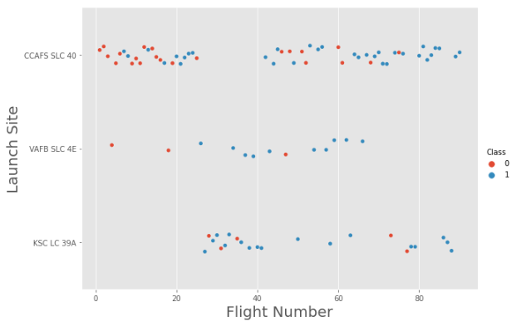
Flight Number vs. Launch Site
The blue dots represent the successful launches while the red dots represent unsuccessful launches.
The success of landing increased as flight number increased.

Slide 18
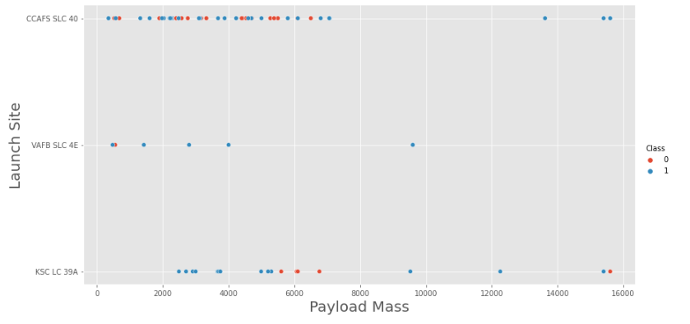
Payload vs. Launch Site
Most of the launches were carried out at CCSFS SLC-40, followed by KSC LC-39A and least launches were carried out at VAFB SLC 4E

Slide 19
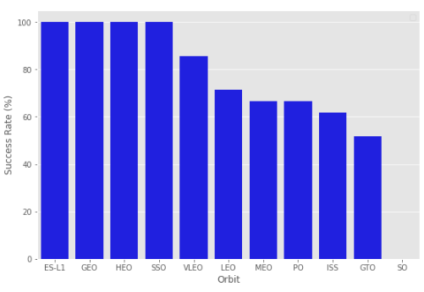
Success Rate vs. Orbit Type
Orbits SSO, HEO, GEO, and ES-L1 have 100% success rates.
SO orbit did not have any successful launches with a 0% success rate.
Other orbits such as VLEO, LEO, MEO, PO, ISS and GTO recorded success rates above 50%

Slide 20
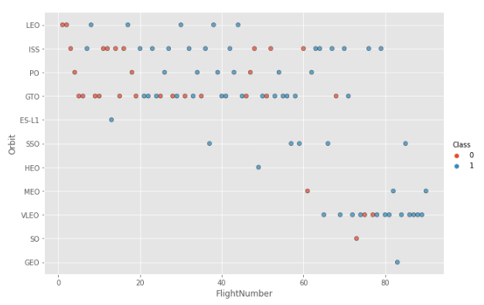
Flight Number vs. Orbit Type
There seems to be no relationship between flight number in the GTO orbit.
In the LEO orbit, the success is positively correlated to the the number of flights.

Slide 21
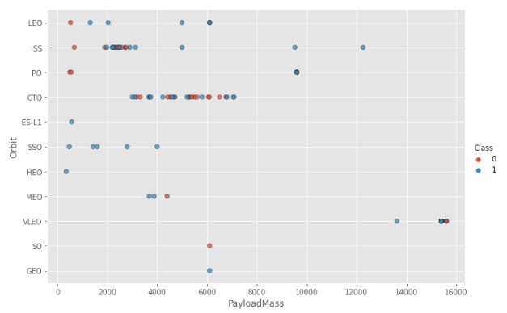
Payload vs. Orbit Type
We observe that Heavy payloads have a negative influence on GTO orbits and positive on Polar LEO and ISS orbits.
There seems to be no direct correlation between orbit type and payload mass for GTO orbit as both successful and failed launches are equally present

Slide 22
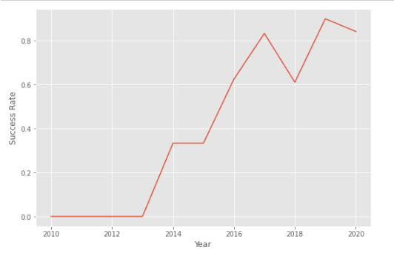
Launch Success Yearly Trend
We can observe that the success rate since 2013 kept increasing till 2020
There was however recorded failure rates in 2018 as well as in 2020.

Slide 23
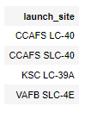
All Launch Site Names
The DISTINCT clause was used to return only the unique rows from the launch_site column.
The names of the launch sites are CCAFS LC-40, CCAFS SLC-40, KSC LC-39A, VAFB SLC-4E .

Slide 24
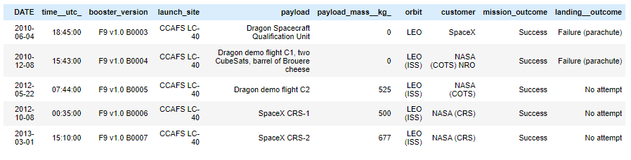
Launch Site Names Begin with 'CCA'
The LIMIT and LIKE clauses were used to display only the top five results where the launch_site name starts with 'CCA'

Slide 25
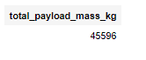
Total Payload Mass
The SUM() function was used to the calculate the total payload carried by boosters from NASA from the payload_mass__kg column.

Slide 26
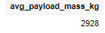
Average Payload Mass by F9 v1.1
The AVG() function was used to the calculate the average payload the average payload mass carried by booster version F9 v1.1
The WHERE clause was used to filter results so that the calculations were only performed on booster_versions only if they were named “F9 v1.1”

Slide 27
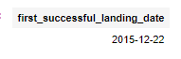
First Successful Ground Landing Date
The MIN(DATE) function was used to find the date of the first successful landing outcome on ground pad
The WHERE clause ensured that the results were filtered to match only when the 'landing_outcome' column is 'Success (ground pad)'

Slide 28
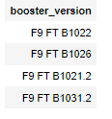
Successful Drone Ship Landing with Payload between 4000 and 6000
The BETWEEN clause was used to retrieve only those results of payload mass greater than 4000 but less than 6000. The WHERE clause filtered the results to include only boosters which successfully landed on drone ship

Slide 29
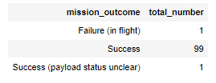
Total Number of Successful and Failure Mission Outcomes
The COUNT() function is used to count the number of occurrences of different mission outcomes with the help of the GROUPBY clause applied to the 'mission outcome' column. A list of the total number of successful and failure mission outcomes returned.
There have been 99 successful mission outcomes out of 101 missions.

Slide 30
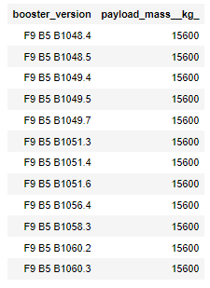
Boosters Carried Maximum Payload
The MAX() function was used in a subquery to retrieve a list of boosters which have carried the maximum payload mass

Slide 31
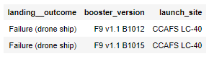
2015 Launch Records
The SELECT statement was used to retrieve multiple columns from the table. The YEAR(DATE) function was used to retrieve only those rows with a 2015 launch date.

Slide 32
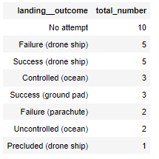
Rank Landing Outcomes Between
2010-06-04 and 2017-03-20
COUNT() function was used to count the different landing outcomes.'The WHERE and BETWEEN clauses filtered the results to only include results between 2010-06-04 and 2017-03-20. The GROUPBY clause ensure that the counts were grouped by their outcome. The ORDERBY and DESC clauses were used to sort the results by descending order.

Slide 33

Section 3
Section 3

Slide 34
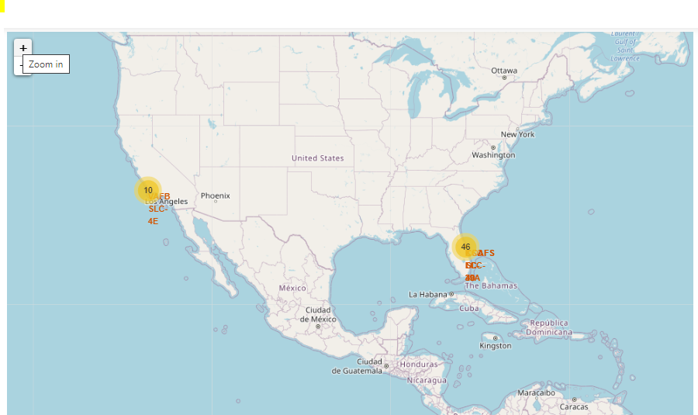
SpaceX Launch Sites Locations
The yellow markers are indicators of where the locations of all the SpaceX launch sites are situated in the US.
The launch sites have been strategically placed near the coast

Slide 35
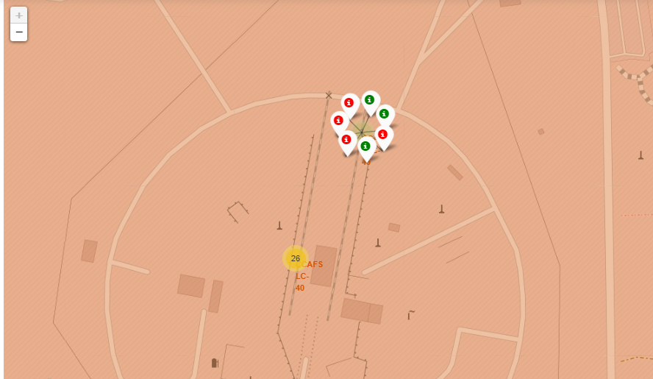
Success or Failure?
When we zoom in on a launch site, we can click on the launch site which will display marker clusters of successful landings (green markers) or failed landing (red markers).

Slide 36
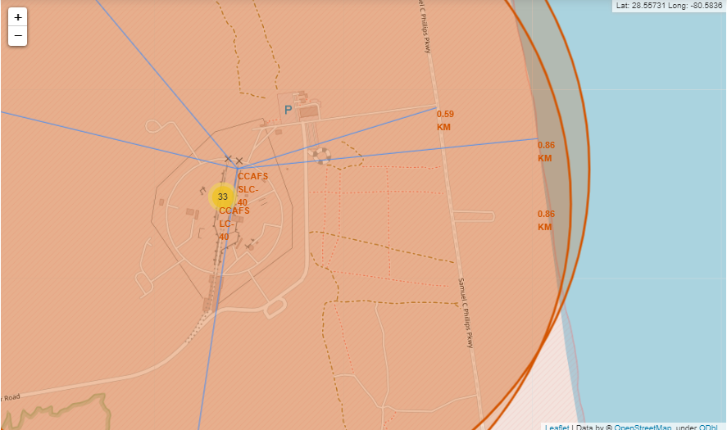
Launch Site Distance to Landmarks
The generated map shows that the selected launch site is close to a highway for transportation of personnel and equipment. The launch site is also close to the coastlines for launch failure testing.

Slide 37

Section 4
Section 4

Slide 38
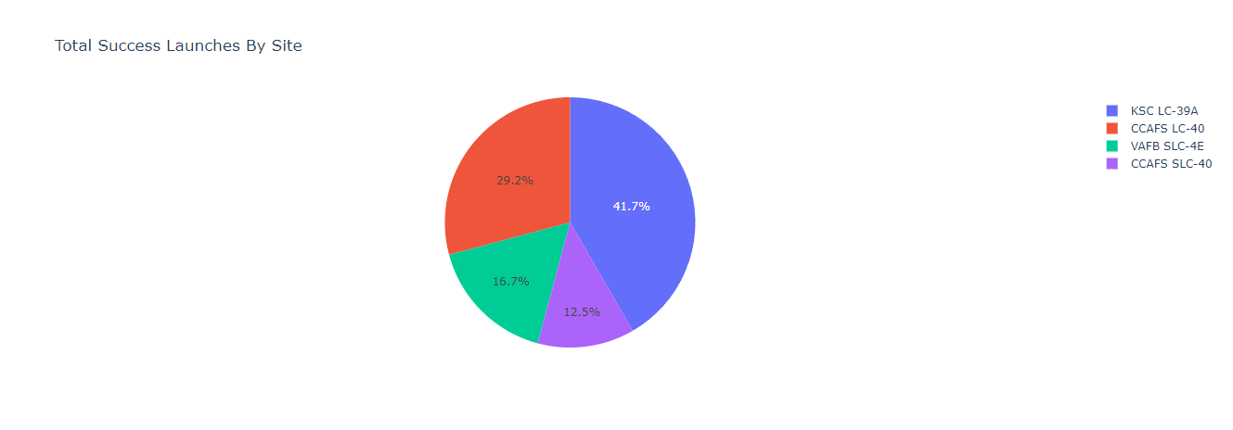
Total Successful Launches By Site
The KSC LC-39A Launch site had the most successful launches with 10 in total.

Slide 39
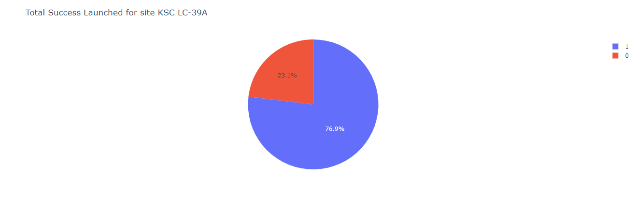
Launch Site With Highest Success Ratio
The KSLC-39A has the highest success rate with 76.9%.

Slide 40
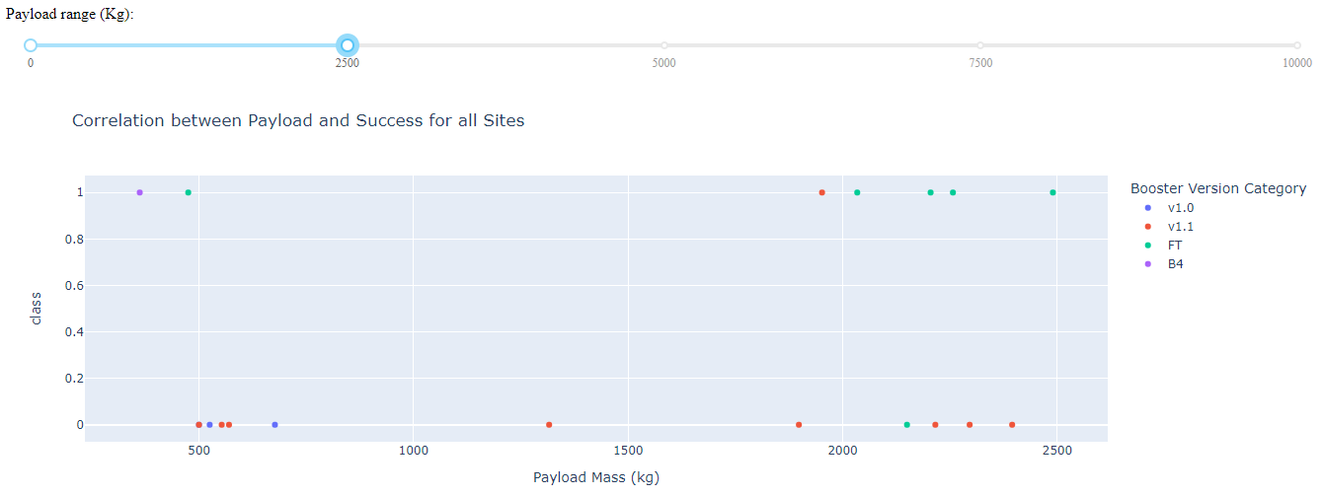
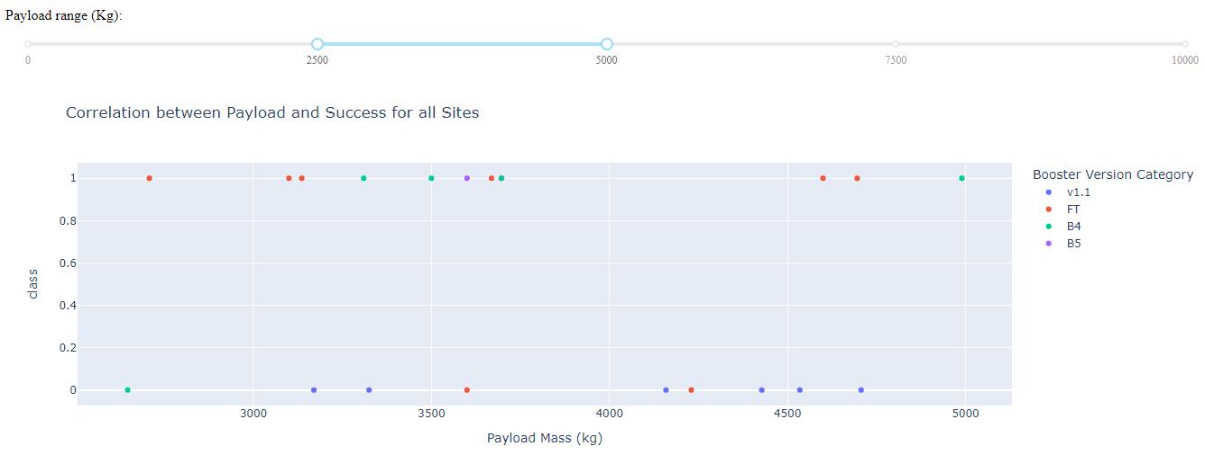
Payloads vs Launch Outcome
The launch success rate for payloads 0-2500 kg is slightly lower than that of payloads 2500-5000 kg. There is in fact not much difference between the two.
The booster version that has the largest success rate, in both weight ranges is the v1.1.

Slide 41

Section 5
Section 5

Slide 42
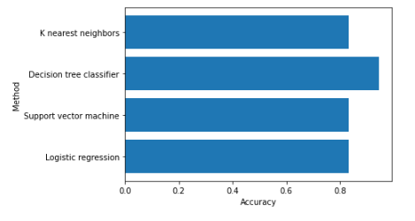
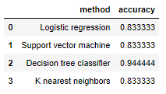
Classification Accuracy
The Decision Tree classifier had the best accuracy at 94%.

Slide 43

Confusion Matrix
The model predicted 12 successful landings when the True label was successful (True Positive) and 3 unsuccessful landings when the True label was failure (True Negative).
The model also predicted 3 successful landings when the True label was unsuccessful landing (False Positive).
The model generally predicted successful landings.

Slide 44
Conclusions
The larger the flight amount at a launch site, the greater the success rate at a launch site
Orbits ES-L1, GEO, HEO, SSO, VLEO had the most success rate.
Success rate can be linked to payload mass as the lighter payloads generally proved to be more successful than the heavier payloads.
The launch sites are strategically located near highways and railways for transportation of personnel and cargo, but also far away from cities for safety.
The Decision tree classifier is the best machine learning algorithm for this task
Launch success rate started to increase in 2013 till 2020

Slide 45
Appendix
GitHub Repository:
https://github.com/rmbanga/Space-X-Landing-Success-Prediction

Slide 46


